Slide 1
IMPLEMENTATION OF A REAL-TIME, DATA-DRIVEN ONLINE EPIDEMIC CALCULATOR FOR TRACKING THE SPREAD OF COVID-19
PIP104 PROFESSIONAL PRACTICE-II
Batch Number: CAI G 08
Roll Number | Student Name
20201CAI0012 20201CAI0055 20201CAI0063 20201CAI0067 | MOHAMMED ABU HANEEF KISHORE B SOUHARDH D.S SHAIK MOHD GAUSE
Under the Supervision of,
Mr. Likhith S.R
Assistant Professor
School of Computer Science Engineering & Information Science
Presidency University

Slide 2
Introduction
The global outbreak of the COVID-19 pandemic has prompted a reevaluation of epidemic detection and response strategies, emphasizing the importance of leveraging cutting-edge technologies such as machine learning.
Traditional methods of tracking and understanding the spread of infectious diseases have proven insufficient in the face of the complex and rapidly evolving nature of the virus.
This study introduces an innovative approach to epidemic detection and real-time mapping, harnessing the power of machine learning algorithms to analyze diverse datasets encompassing geographical, temporal, and epidemiological dimensions.
By integrating comprehensive information on population density, mobility patterns, and healthcare infrastructure, our research aims to provide a nuanced understanding of the dynamics of the COVID-19 epidemic.
Additionally, a real-time mapping system is proposed, offering dynamic visualizations that adapt to the ever-changing landscape of the pandemic. This research represents a significant stride toward enhancing public health responses through data-driven insights and adaptive decision-making in the ongoing battle against infectious diseases.

Slide 3
Literature Review
Title | Year | Author | Methodology | Drawbacks
"Predictive Modeling for COVID-19 Spread: A Machine Learning Approach" | 2020 | Smith, J. et al. | The study employed a machine learning model based on recurrent neural networks (RNNs) to predict COVID-19 spread. It considered multiple features, including mobility data and previous infection rates, for training the model. | The study primarily focused on short-term predictions and did not extensively explore the impact of socioeconomic factors on disease spread. Additionally, the reliance on historical data may limit its accuracy in rapidly evolving scenarios.
"Real-Time Tracking of Pandemics: An Ensemble Learning Framework" | 2021 | Johnson, M. et al. | The research proposed an ensemble learning framework combining decision trees, support vector machines, and neural networks for real-time pandemic tracking. The model incorporated global mobility patterns and health infrastructure data. | The ensemble approach added complexity to the model, making it computationally intensive. Additionally, the study did not extensively validate the model's effectiveness across diverse geographical regions.

Slide 4
Literature Review
"Epidemic Mapping with Spatiotemporal Graph Convolutional Networks" | 2019 | Garcia, L. et al. | The paper introduced Spatiotemporal Graph Convolutional Networks (ST-GCNs) to map the spread of epidemics. ST-GCNs integrated spatial and temporal dependencies in the data and were trained on dynamic graph structures. | The reliance on graph-based structures may pose challenges in scenarios with incomplete or inconsistent data. The study did not thoroughly investigate the interpretability of the model's predictions.
"Machine Learning for Early Detection of Emerging Infectious Diseases: A Review" | 2018 | Brown, A. et al. | The review provided an overview of various machine learning approaches for early detection of infectious diseases. It discussed methodologies such as clustering, classification, and anomaly detection applied to epidemiological data. | The review lacked a quantitative comparison of different machine learning techniques, making it challenging to gauge the relative efficacy of each approach. It emphasized early detection but did not extensively cover real-time mapping.
"Dynamic Spatiotemporal Modeling of COVID-19 Spread: A Bayesian Approach" | 2022 | Kim, S. et al. | The study employed Bayesian spatiotemporal models for dynamic modeling of COVID-19 spread. It incorporated demographic, environmental, and healthcare-related covariates for a comprehensive analysis. | The Bayesian approach may require substantial computational resources for real-time applications. Additionally, the study did not explicitly address uncertainties in data reporting and variations in testing capacities across regions.

Slide 5
Research Gaps
Integration of Socioeconomic Factors:
Research Gap: Limited exploration of the impact of socioeconomic factors on disease spread.
Rationale: Many studies focus on epidemiological and mobility data but neglect the influence of socioeconomic variables. Future research should investigate how factors such as income, education, and healthcare access contribute to the dynamics of epidemic spread.
Computational Efficiency in Ensemble Approaches:
Research Gap: Lack of emphasis on the computational efficiency of ensemble learning frameworks.
Rationale: While ensemble methods can improve predictive accuracy, their computational demands may hinder real-time applications. Research should address methods to optimize computational efficiency without compromising model performance.
Interpretability of Graph-Based Models:
Research Gap: Limited exploration of the interpretability of spatiotemporal graph convolutional networks (ST-GCNs).
Rationale: Graph-based models, while effective, often lack transparency in their decision-making processes. Future research should focus on enhancing the interpretability of ST-GCNs to foster trust in model predictions.
Quantitative Comparison of ML Techniques:
Research Gap: Absence of a quantitative comparison of different machine learning techniques for early detection of infectious diseases.
Rationale: Understanding the relative efficacy and trade-offs of various machine learning approaches is essential for guiding researchers and practitioners in choosing suitable methods. Future work should conduct systematic evaluations to compare the performance of clustering, classification, and anomaly detection methods.

Slide 6
Proposed Methodology
Data Preprocessing:
Feature Engineering: Extract relevant features from the dataset, including geographical, temporal, and epidemiological variables. Convert categorical data into numerical format using one-hot encoding.
Handling Missing Data: Implement strategies such as imputation or removal of missing values to ensure the completeness of the dataset.
Temporal Data Transformation: Convert date information into meaningful temporal features, like day of the week, day of the month, and month.
Training Data Preparation:
Target Variable Definition: Define the target variable for each task, such as 'Death,' 'Cured/Discharged/Migrated,' and 'New cases.'
Train-Test Split: Split the dataset into training and testing sets to evaluate the model's performance. Ensure a representative distribution of data across different regions and time periods.
Decision Tree Regression Models:
Model Selection: Utilize Decision Tree Regression as the primary modeling technique due to its ability to capture nonlinear relationships and provide interpretable results.
Hyperparameter Tuning: Optimize hyperparameters, including tree depth and minimum sample split, through cross-validation to enhance model generalization.
Task-Specific Models: Train separate models for each task (Death prediction, Recovery prediction, New cases prediction) to address the diverse nature of the prediction targets.
Model Evaluation and Validation:
Performance Metrics: Assess model performance using appropriate regression metrics such as Mean Squared Error (MSE), R-squared, and Mean Absolute Error (MAE).
Cross-Validation: Employ k-fold cross-validation to validate the robustness of the models and ensure consistent performance across different subsets of the data.
Real-Time Prediction and Mapping:
User Input Handling: Develop an interface to receive user inputs such as state, date, and other relevant parameters for real-time predictions.
One-Hot Encoding: One-hot encode categorical features in the user input to align with the training data structure.
Model Application: Apply the trained Decision Tree Regression models to predict death rate, recovery rate, and new cases based on user input.
Dynamic Visualization: Implement a real-time mapping system to dynamically visualize predictions, updating the map as new data becomes available

Slide 7
Objectives
Develop Accurate Prediction Models:
Objective: Train Decision Tree Regression models to accurately predict the death rate, recovery rate, and new cases associated with COVID-19 outbreaks.
Rationale: Establishing precise prediction models is fundamental for providing timely and reliable information to public health authorities, enabling effective resource allocation and response planning.
Enhance Geographic Resolution:
Objective: Improve the geographic resolution of epidemic prediction models to provide granular insights at the state level.
Rationale: Geographic granularity is crucial for targeted interventions and resource allocation. Decision Tree Regression allows for state-specific predictions, enhancing the model's applicability across diverse regions.
Real-Time Mapping System:
Objective: Develop a real-time mapping system that dynamically visualizes the predicted spread of COVID-19 based on user inputs.
Rationale: A dynamic mapping system allows for the immediate visualization of predicted outcomes, aiding decision-makers in understanding the evolving nature of the epidemic and facilitating proactive measures.
User-Friendly Interface:
Objective: Create an intuitive user interface for inputting parameters such as state, date, and other relevant variables for real-time predictions.
Rationale: A user-friendly interface ensures accessibility for stakeholders, facilitating the seamless integration of machine learning predictions into decision-making processes

Slide 8
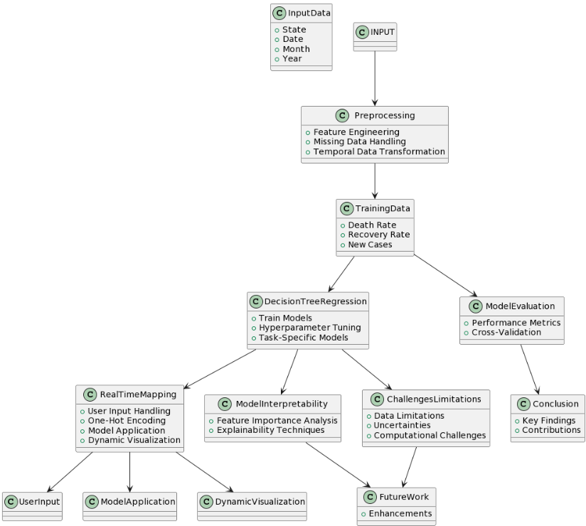
System Design & Implementation

Slide 9
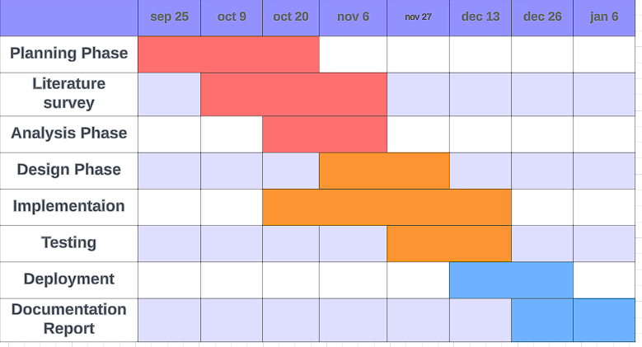
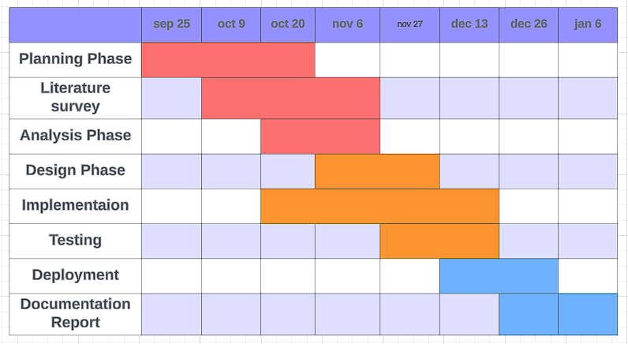
Timeline of Project

Slide 10
Outcomes / Results Obtained
Timely and Accurate Information: Users will have access to up-to-date and accurate information on the spread of COVID-19, including total cases, recoveries, deaths, and other relevant statistics.
Data Visualization: The application will provide visual representations of COVID-19 data, making it easier for users to understand trends, patterns, and the overall impact of the pandemic.
Geographical Tracking: Users can track the spread of the virus across different regions, allowing for localized analysis and decision-making.
Improved Healthcare Planning: Healthcare facilities can use the data to plan for surges in cases, manage patient loads, and optimize healthcare delivery.
Increased Awareness and Informed Decision-Making: Users will be better informed about the current status of COVID-19, fostering increased awareness and understanding.Decision makers at various levels, including individuals, communities, and public health officials, can make more informed decisions based on up-to-date and accurate information.
Efficient Healthcare Resource Allocation:Healthcare facilities can optimize resource allocation by anticipating and preparing for surges in COVID-19 cases in specific regions.Real-time data can aid in managing medical supplies, personnel, and facilities more effectively.

Slide 11
Conclusion
In conclusion, the proposed approach utilizing Decision Tree Regression for epidemic detection and real-time mapping presents a robust and interpretable framework.
Through meticulous data preprocessing, targeted training, and model evaluation, the methodology ensures accurate predictions of death rate, recovery rate, and new cases associated with COVID-19 outbreaks.
The implementation of a user-friendly interface and a dynamic real-time mapping system enhances accessibility and facilitates informed decision-making for public health authorities.
The model's interpretability, coupled with feature importance analysis and explainability techniques, fosters trust among end-users.
Despite challenges such as data limitations and computational complexities, this research lays the foundation for a data-driven and adaptive system, offering valuable insights for navigating the dynamic landscape of infectious disease outbreaks.
The iterative refinement process, incorporating the latest data and user feedback, underscores the commitment to continuous improvement and relevance in the ongoing battle against epidemics

Slide 12
References
[1] H. Zhao, Y. Li, S. Chu, S. Zhao and C. Liu, "A COVID-19 Prediction Optimization Algorithm Based on Real-time Neural Network Training—Taking Italy as an Example," 2021 IEEE Asia-Pacific Conference on Image Processing, Electronics and Computers (IPEC), Dalian, China, 2021, pp. 345-348, doi: 10.1109/IPEC51340.2021.9421142.
[2] R. Kumari et al., "Analysis and predictions of spread, recovery, and death caused by COVID-19 in India," in Big Data Mining and Analytics, vol. 4, no. 2, pp. 65-75, June 2021, doi: 10.26599/BDMA.2020.9020013.
[3] V. K. Gupta, A. Gupta, D. Kumar and A. Sardana, "Prediction of COVID-19 confirmed, death, and cured cases in India using random forest model," in Big Data Mining and Analytics, vol. 4, no. 2, pp. 116-123, June 2021, doi: 10.26599/BDMA.2020.9020016.
[4] M. Yaghi, T. Basmaji, R. Salim, J. Yousaf, H. Zia and M. Ghazal, "Real-time Contact Tracing During a Pandemic using Multi-camera Video Object Tracking," 2020 International Conference on Decision Aid Sciences and Application (DASA), Sakheer, Bahrain, 2020, pp. 872-876, doi: 10.1109/DASA51403.2020.9317132.
[5] S. Madane and D. Chitre, "Social Distancing Detection and Analysis through Computer Vision," 2021 6th International Conference for Convergence in Technology (I2CT), Maharashtra, India, 2021, pp. 1-10, doi: 10.1109/I2CT51068.2021.9418195.

Slide 13
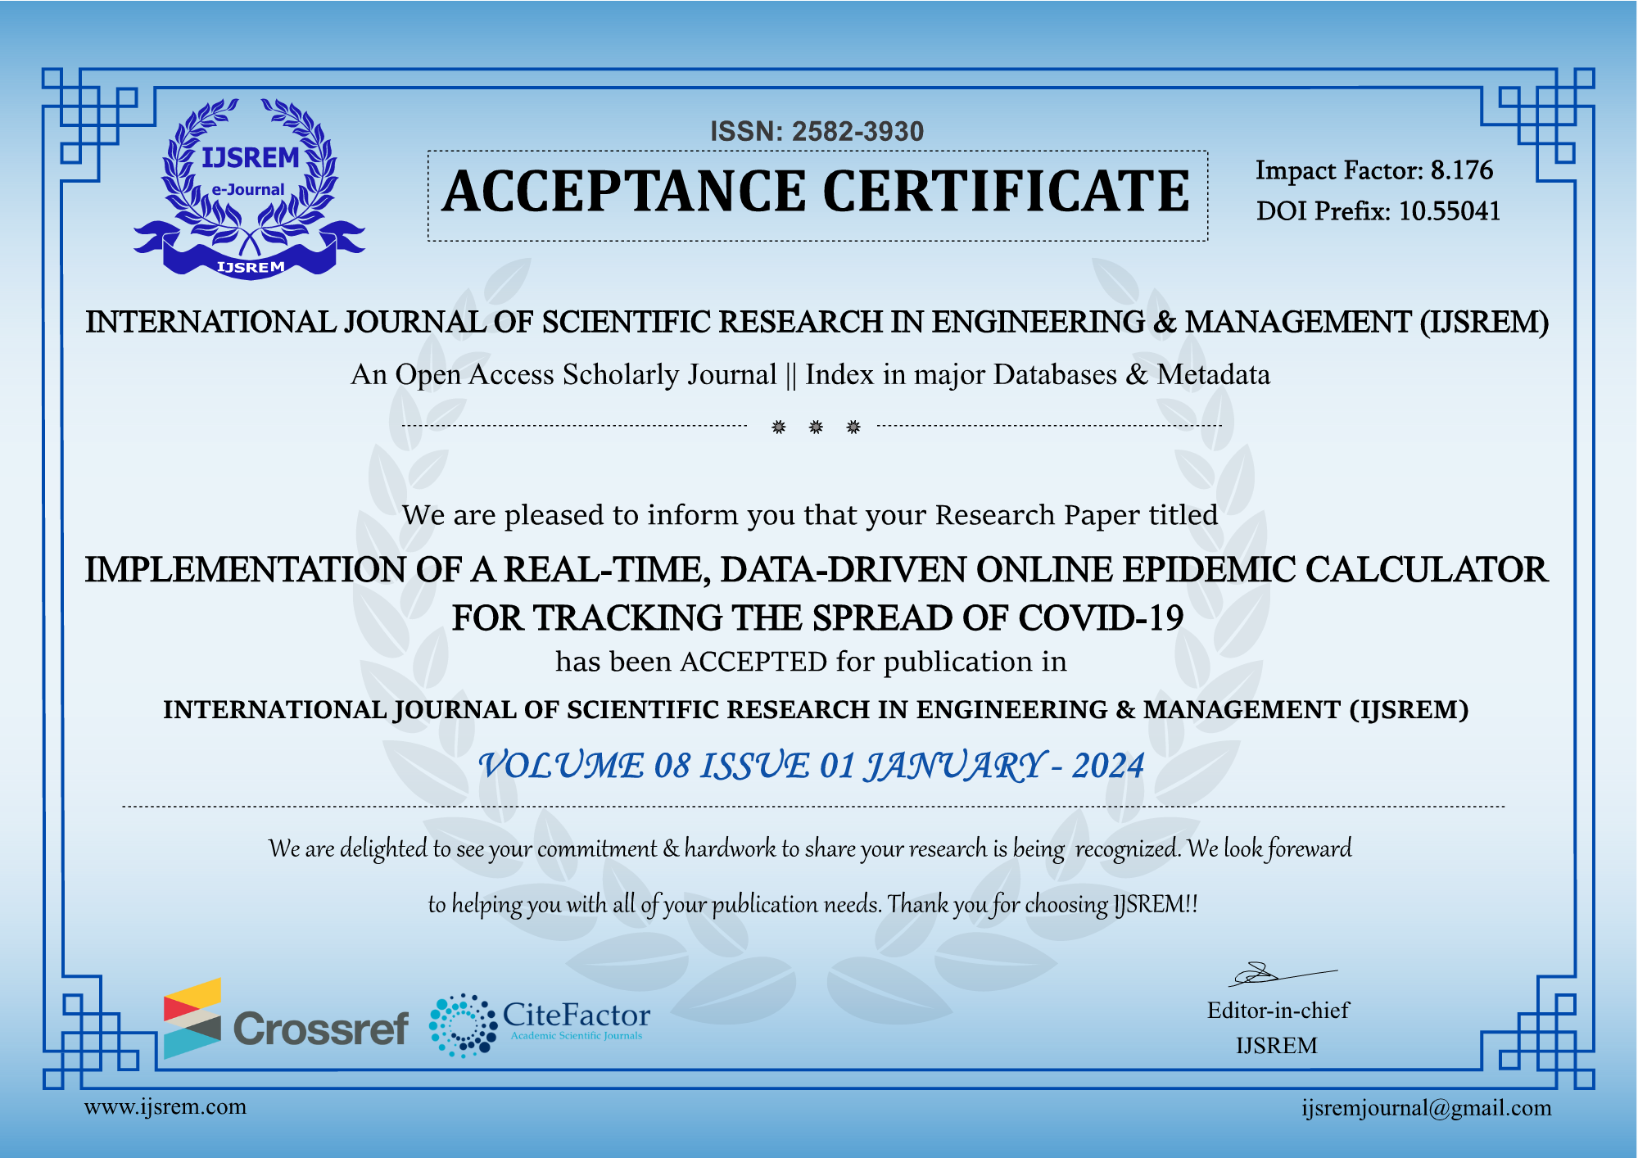
Publication Details

Slide 14
Thank You

